Slide 1
Introduction to Data Structure

Slide 2
Data Structure
Is a particular way of organizing data held in memory inside running application

Slide 3

Is It Important?

Slide 4
Is It Important?
Data everywhere
Processor speed getting faster while data (and/or users) grows
Efficient operations on lots of data
Notes:
10/15 years ago 1 million rows maybe considered as big data,
php says its okay

Slide 5
Today’s outline
Struct
Array
List
Stack
Queue
Associative Array
Hash
Set
Tree
Heap
Graph
Notes:
10/15 years ago 1 million rows maybe considered as big data,
php says its okay

Slide 6
BEFORE we start
Throw away your golden hammer
Concept first syntax later

Slide 7
STRUCT
Grouped list of variables under one name in a block of memory, allowing the different variables to be accessed.
STRUCT | CLASS
Value Type | Reference Type
Lives in the stack | Live in the heap
Faster | Slower
No inheritance

Slide 8
STRUCT
type Person struct {
Name string
Age int
}
p := Person { Name: “Tyar“, Age: 17}
fmt.Println(p) // expected output: { Tyar 17 }

Slide 9
STRUCT: LANGUAGE SUPPORT
Go | Struct
Python | N/A possible via struct module
Javascript | N/A
PHP | N/A

Slide 10
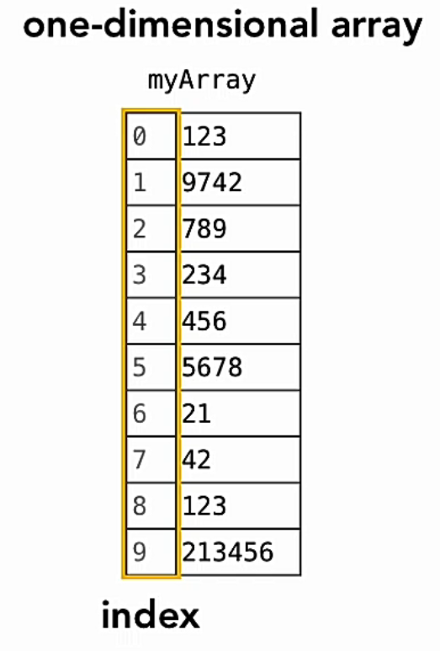
ARRAY
Ordered collection of items, closed inside a named container.
Most commonly used data structured
Simple Arrays:
Zero-based
Fixed-size
Specific data-type
Notes:
Rudimentary of array
Basic Idea of array
The more constraint we, the faster compiler allocate the memory
Container named, items indexed
Index ordered

Slide 11
ARRAY: LANGUAGE SUPPORT
Go | Array, zero-based, fixed size
Python | List, zero-based, resizeable
Javascript | Array, has built in behaviour : sorting, searching
PHP | Array

Slide 12
Dynamic ARRAY
Go | Slices
Python | List, already resizable
Javascript | Array, already resizable
PHP | Array, already resizable

Slide 13
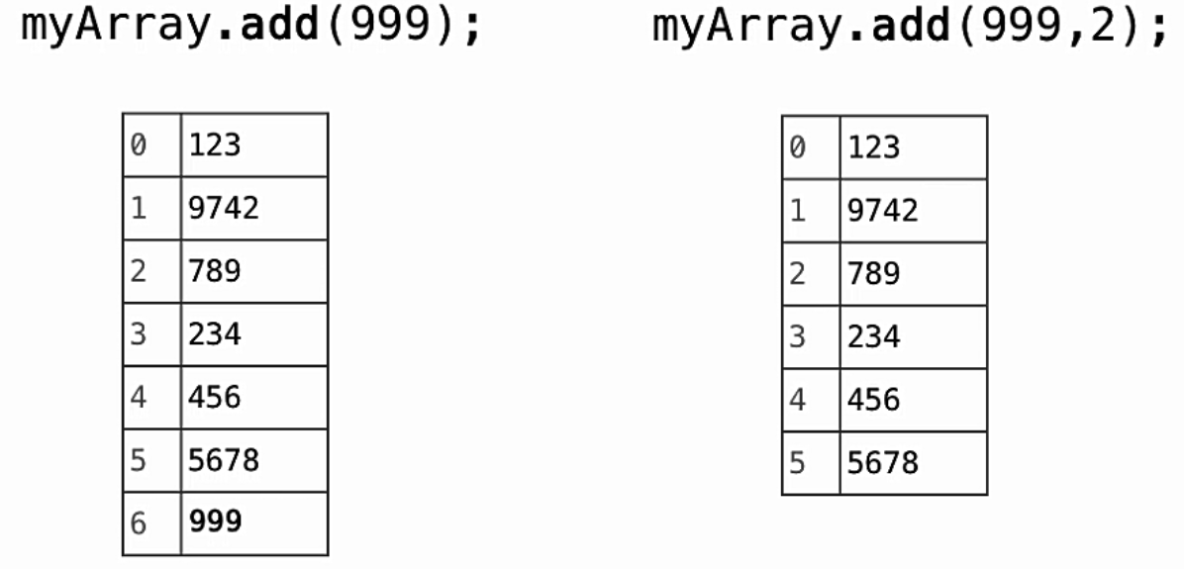
ADDING NEW ELEMENT
adding array element animation

Slide 14
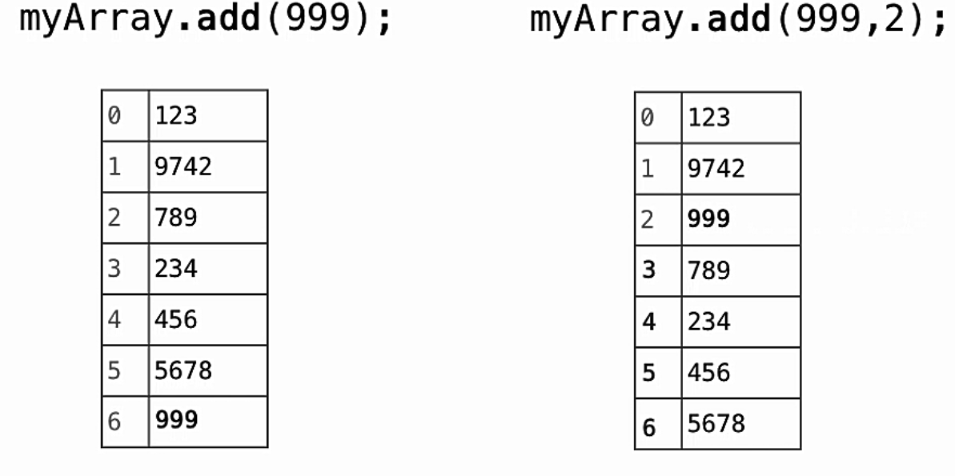
ADDING NEW ELEMENT
adding array element animation

Slide 15
ADDING NEW ELEMENT
Go | append(arr, value(s))
Python | arr.append(value)
Javascript | arr.push(value)
PHP | array_push(arr, value(s))

Slide 16
ADDING NEW ELEMENT at specific index
Go | N/A, possible via slice method
Python | Insert(index, value)
Javascript | splice(index, items_to_remove, items_to_insert)
PHP | array_slice(arr, index, val, is_preserve?)

Slide 17
Removing ELEMENT from array
Go | N/A possible via slice method
Python | pop / remove
Javascript | pop / splice
PHP | unset / array_slice

Slide 18
5 fundamental operation of any ds
How to ACCESS
How to INSERT
How to DELETE
How to FIND
How to SORT
Notes:
Access one item/all
Insert at end/specific position
Delete From end/specific location
Find if exists/at what location
Sort to representing/before insert to db

Slide 19
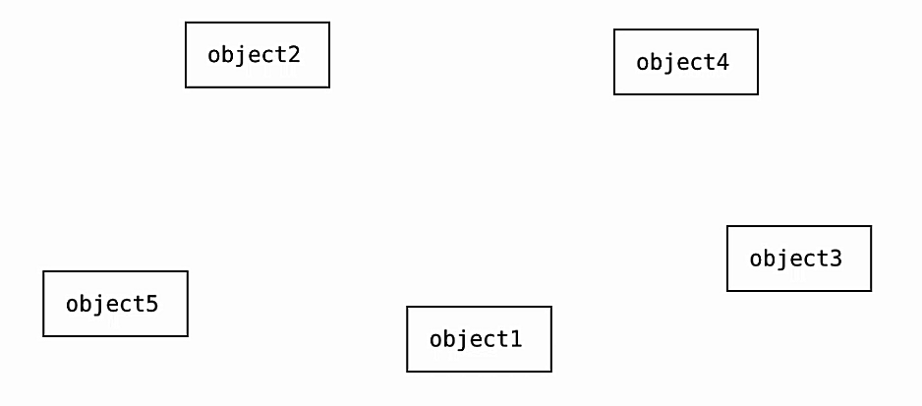
List
Sequential access

Slide 20
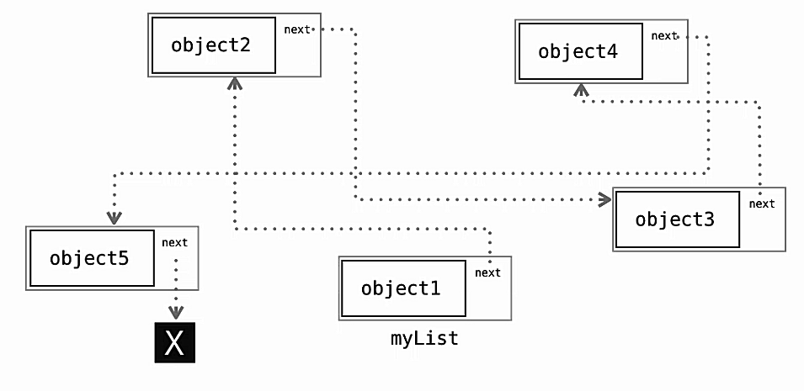
List
Sequential access

Slide 21
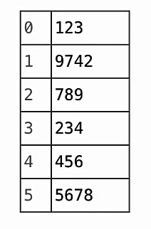
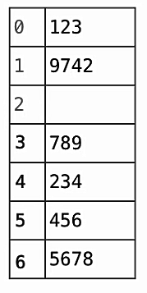
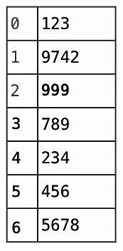
List vs array
Adding / Removing Array Elements

Slide 22
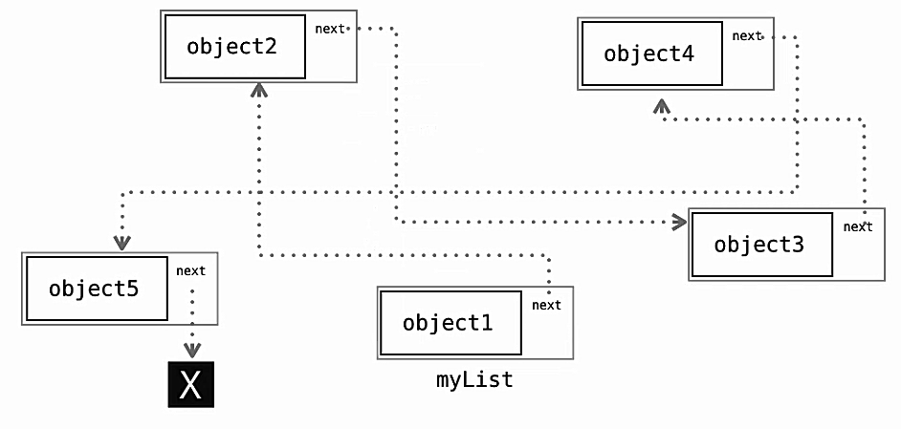
List vs array
Adding / Removing List Elements

Slide 23
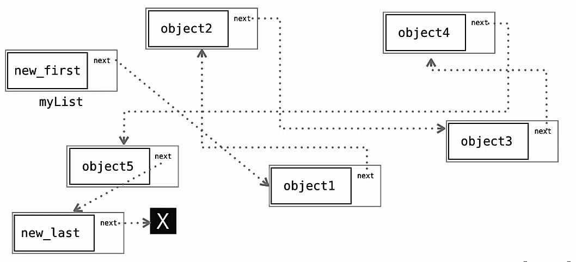
List vs array
Adding / Removing List Elements

Slide 24
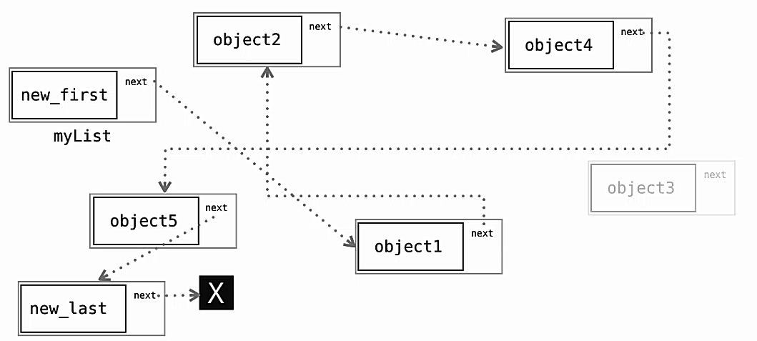
List vs array
Adding / Removing List Elements

Slide 25
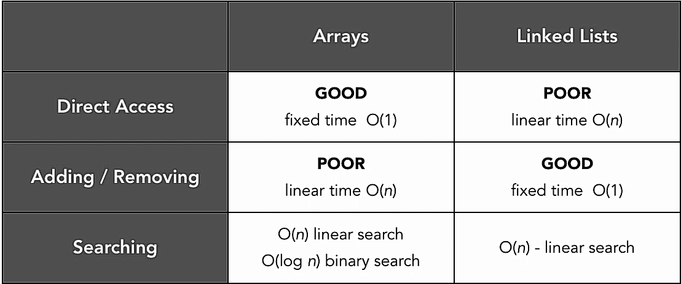
List vs array

Slide 26
Linked list
Nodes containing the data and a pointer to access the next node.
3 types of linked lists.
Singly Linked List
Doubly Linked List
Circular Linked List

Slide 27
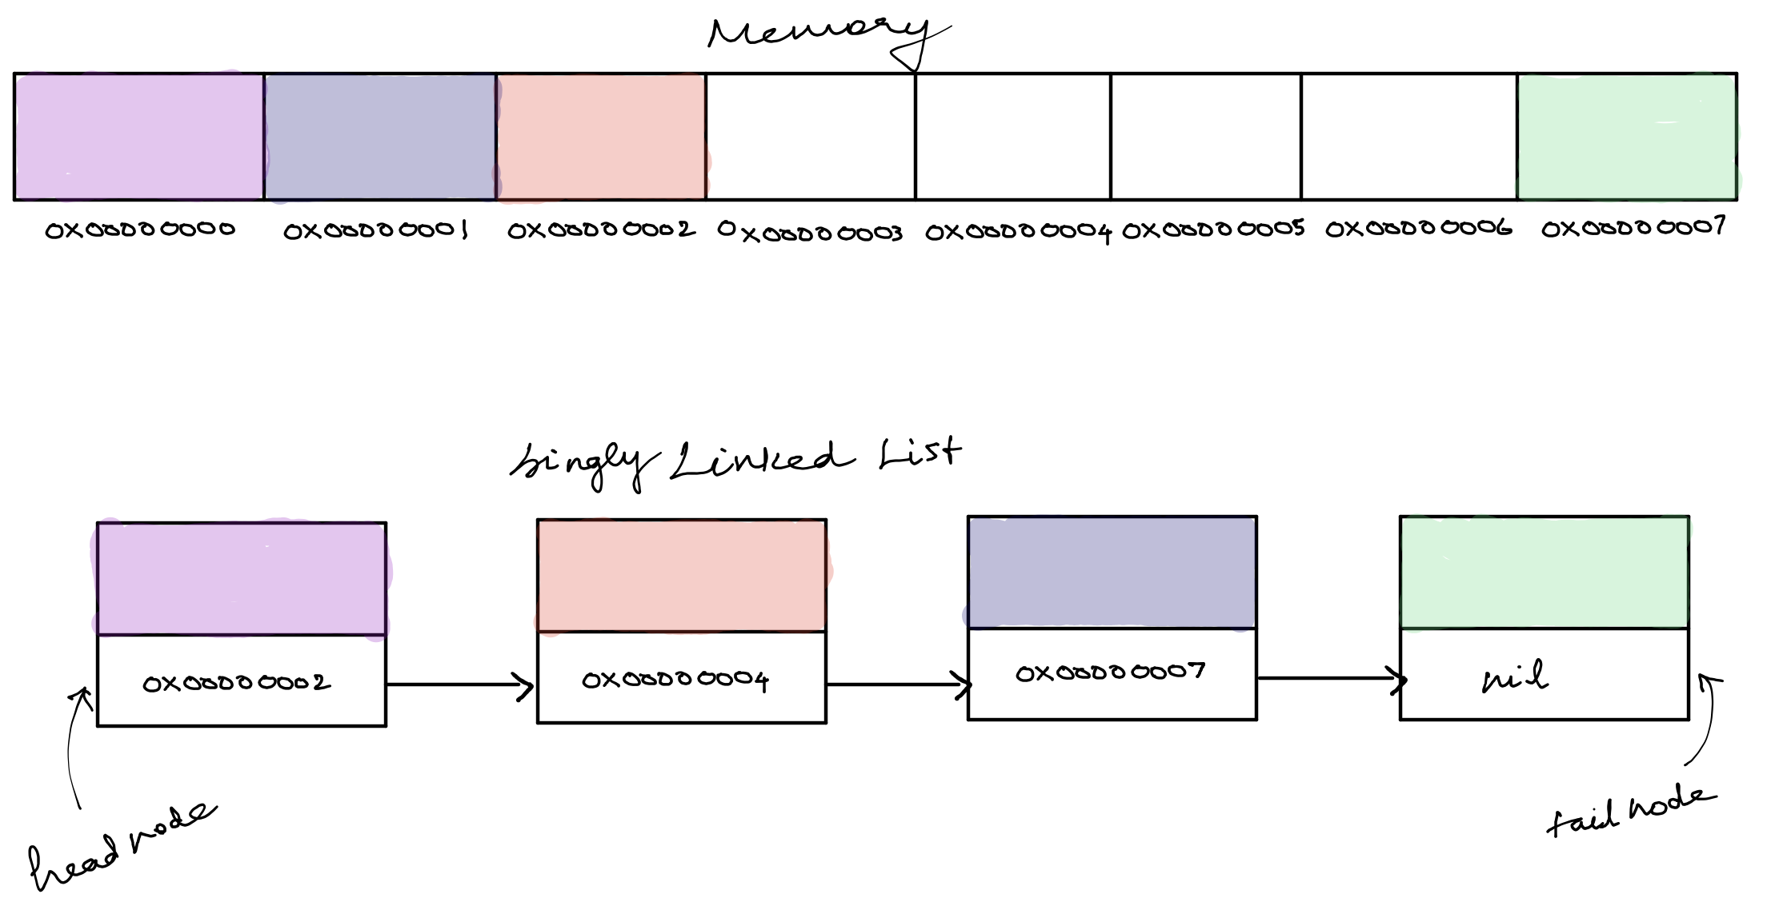
Singly Linked list

Slide 28
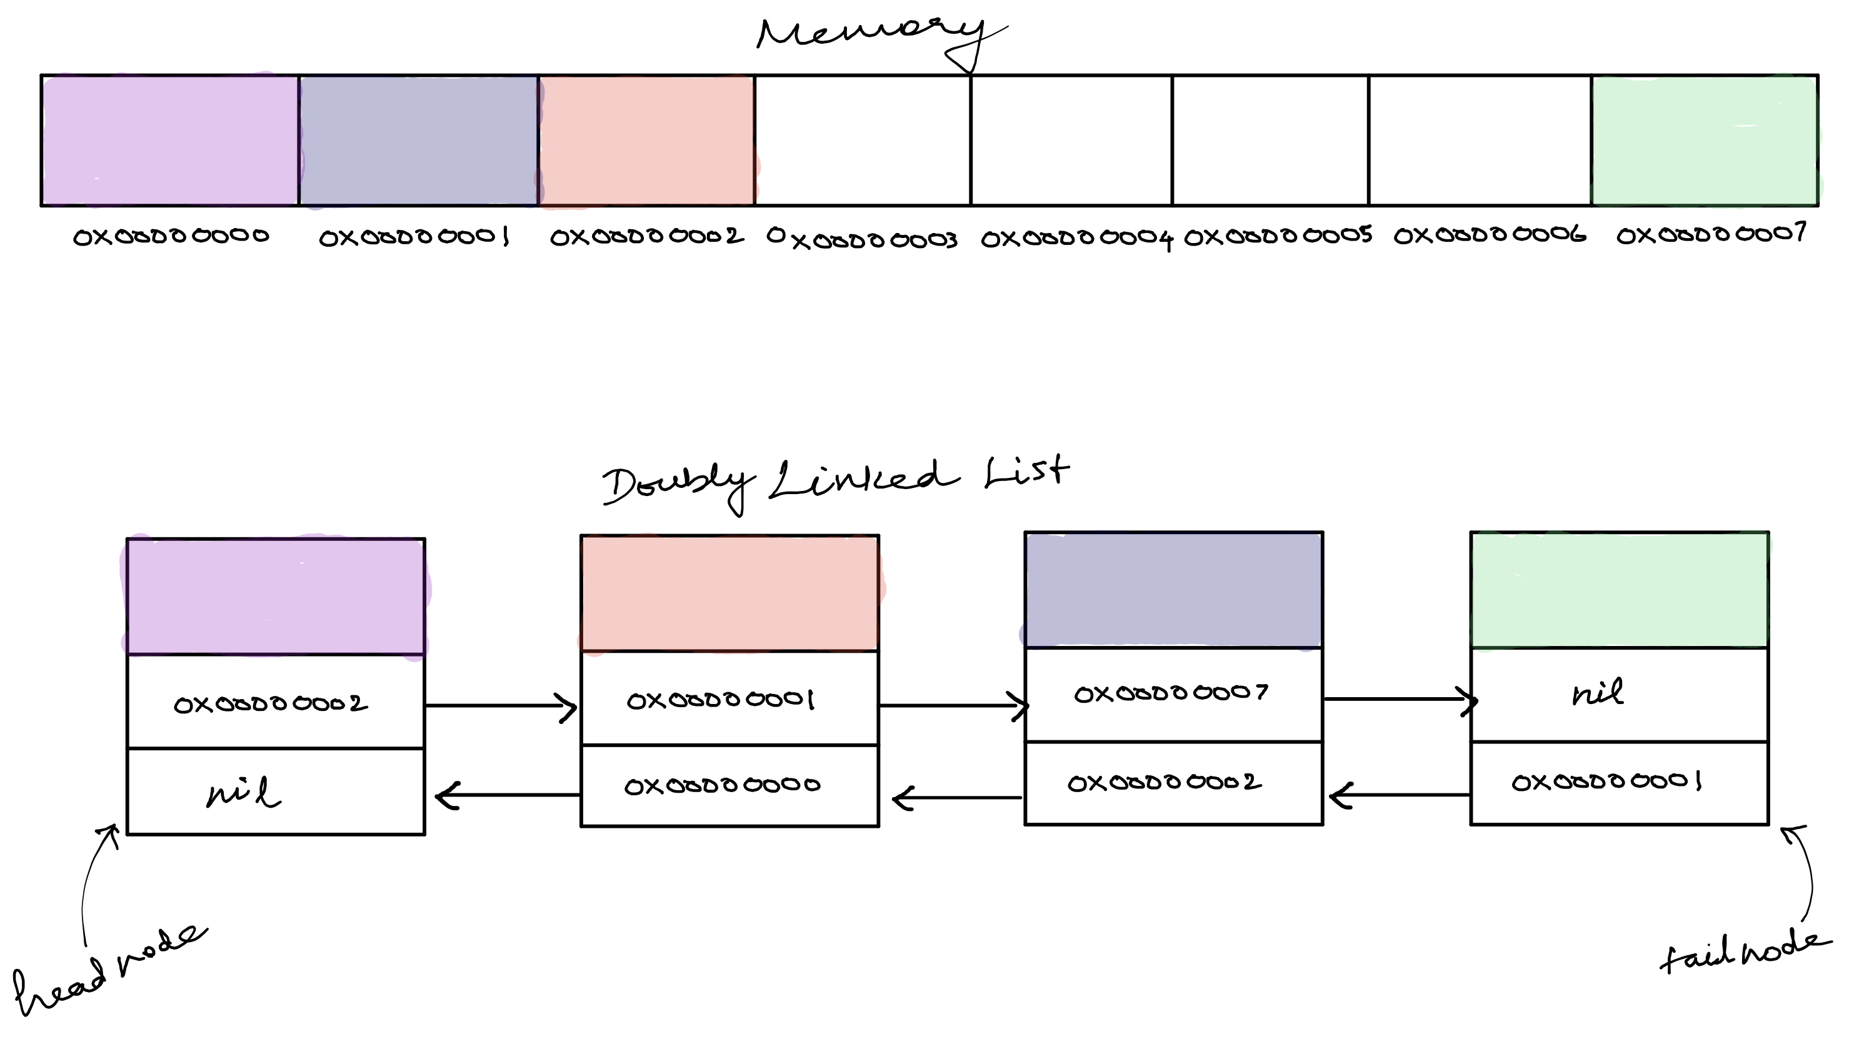
doubly Linked list

Slide 29
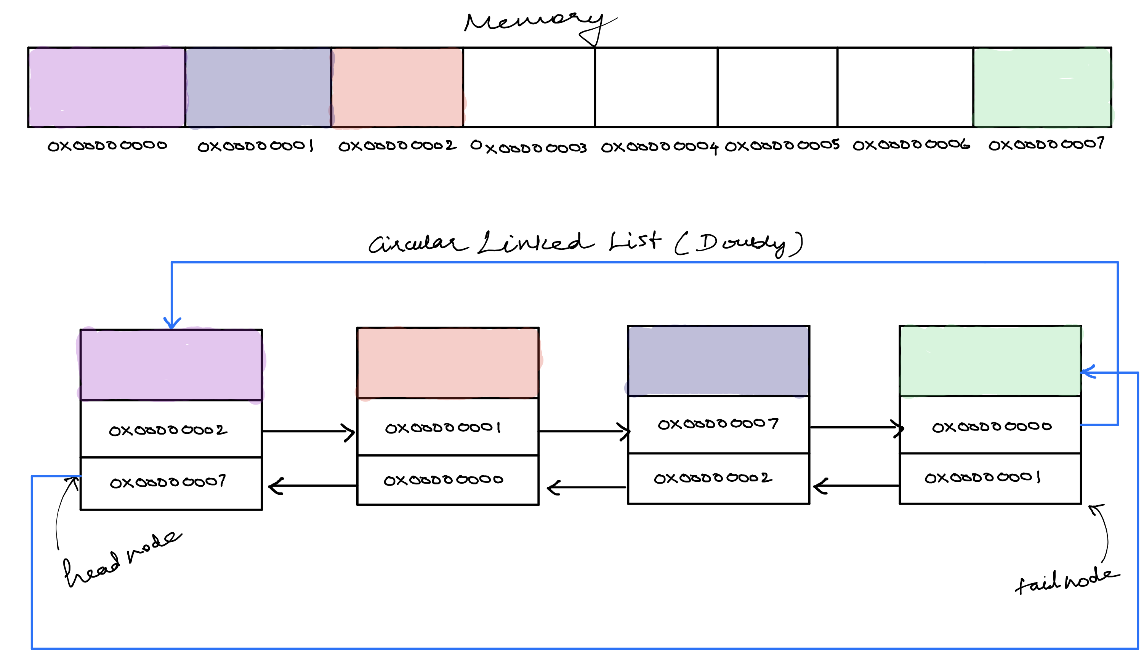
Circular Linked List

Slide 30
Linked list in languages
Go | N/A possible via struct
Python | N/A possible via class
Javascript | N/A possible via class
PHP | SplDoublyLinkedList built-in class

Slide 31
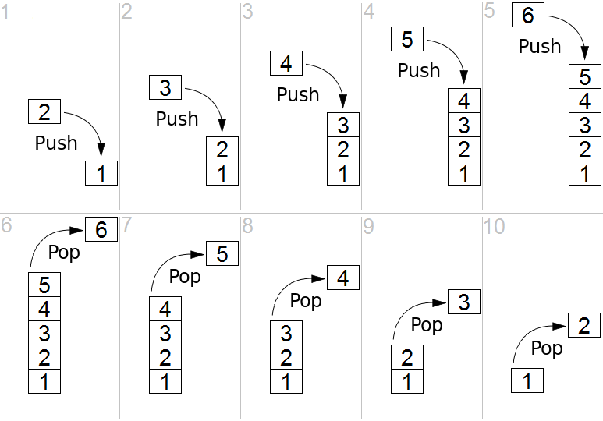
STACK
Is an abstract data type that allows adding and removing elements in a particular order:
push, which adds an element to the collection, and
pop, which removes the most recently added element that was not yet removed.
LIFO structure (last in – first out)

Slide 32
Stack in languages
Go | N/A possible via slices, struct
Python | N/A possible via list, collection
Javascript | N/A possible via class
PHP | N/A possible via class
Notes:
Appliction:
Backtracking

Slide 33
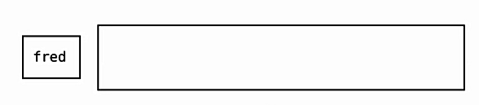
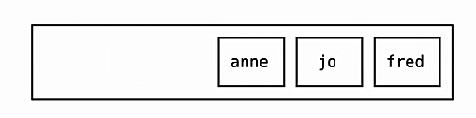
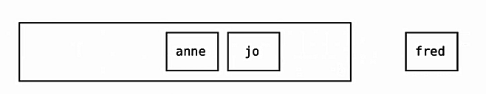
QUEUE
Is data type or a linear data structure,
First element is inserted from one end called the REAR(also called tail),
Removal of existing element takes place from the other end called as FRONT(also called head).
FIFO structure (first in – first out)

Slide 34
queue
Go | queue
Python | queue
Javascript | N/A possible via class, array
PHP | Queue built in class
Notes:
Event handler (js yang dijelasin p ismir)
Printer

Slide 35
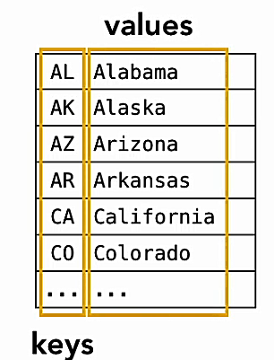
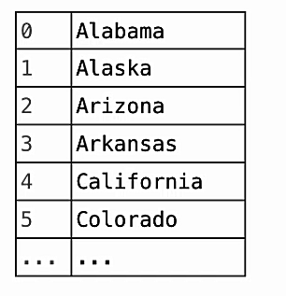
associative array
Is data type composed of a collection of (key, value) pairs
Key must be unique

Slide 36
Associative array in languages
Go | maps
Python | dict
Javascript | Object
PHP | Associative Arrays

Slide 37
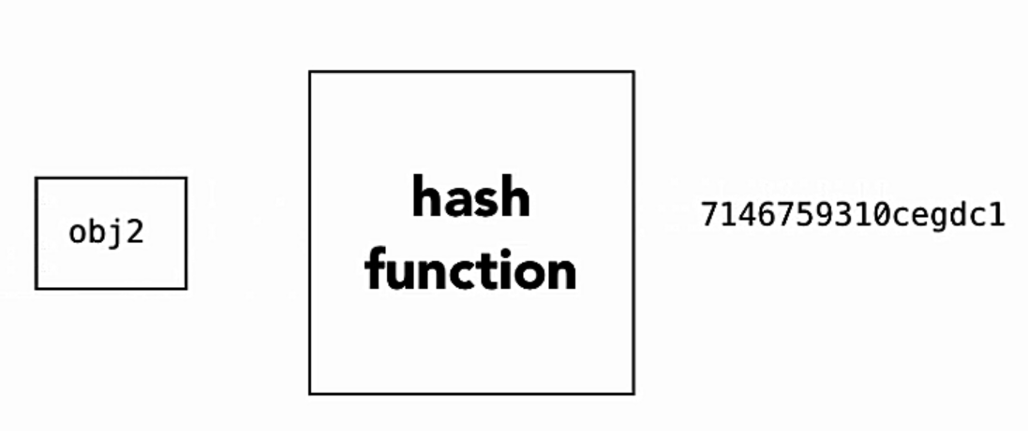
HasH function
A hash function takes a group of characters (called a key) and maps it to a value of a certain length
Hashing is not encryption
Typically one-way
Information is lost when hashing

Slide 38
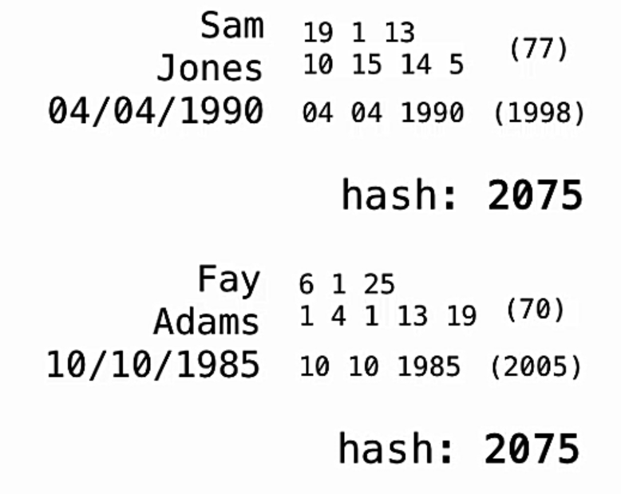
HasH function
Information is lost when hashing
Two objects that equal should return the same hash
The same hash may also result from different objects (referred as Hash Collision)

Slide 39
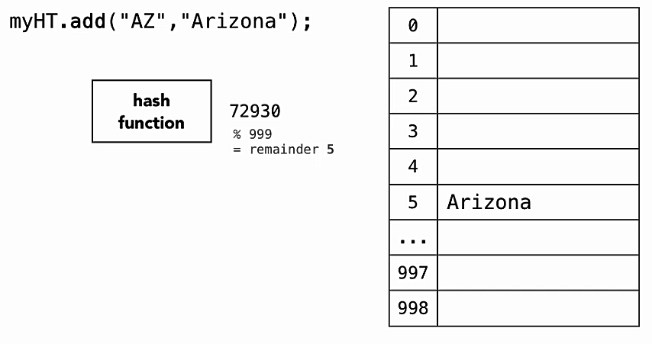
Creating HasH table

Slide 40
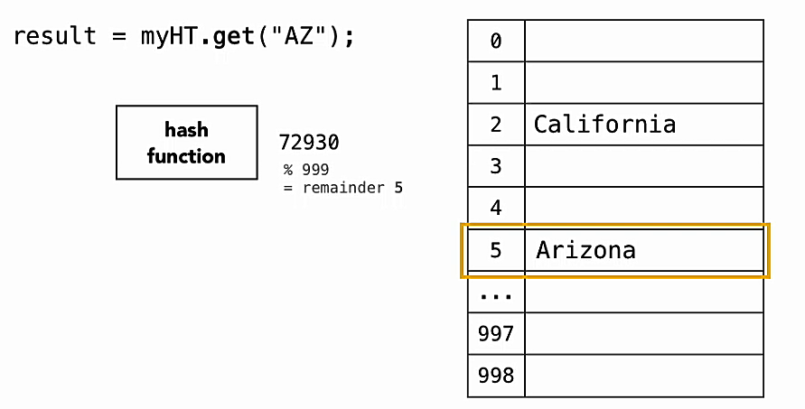
Creating HasH table

Slide 41
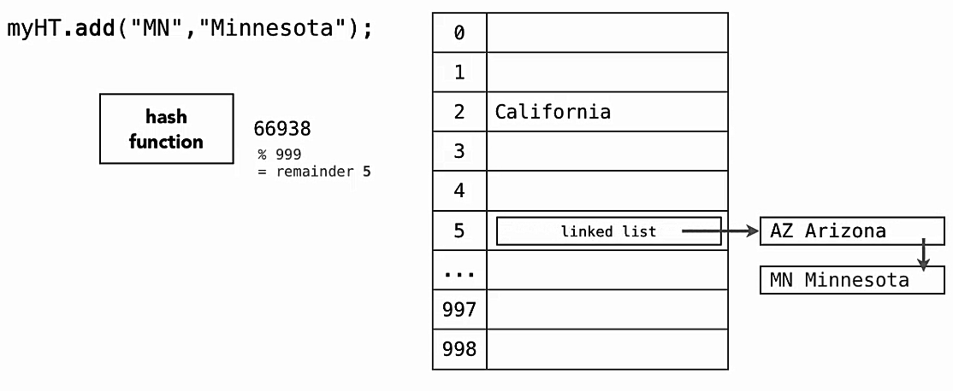
HOW ABOUT HASH COLLISION?

Slide 42
Hash in languages
Go | hash
Python | hash
Javascript | N/A possible via class, function
PHP | hash

Slide 43
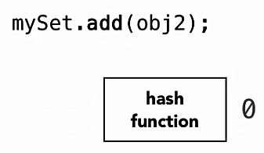
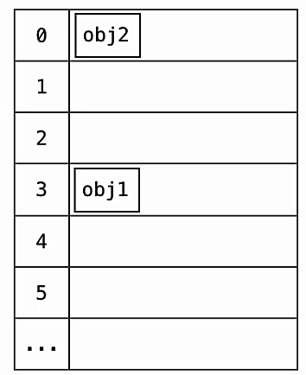
sets
A set is an unordered collection of objects
No Index, sequence, or key
No duplicates
Fast Lookup

Slide 44
Sets in languages
Go | Set
Python | sets
Javascript | Set
PHP | Set

Slide 45
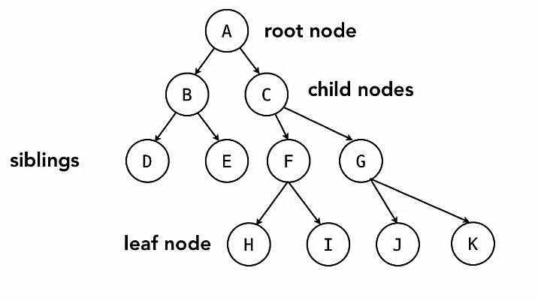
Tree
Collections of objects
Consists of root node, parent node, and child node.

Slide 46
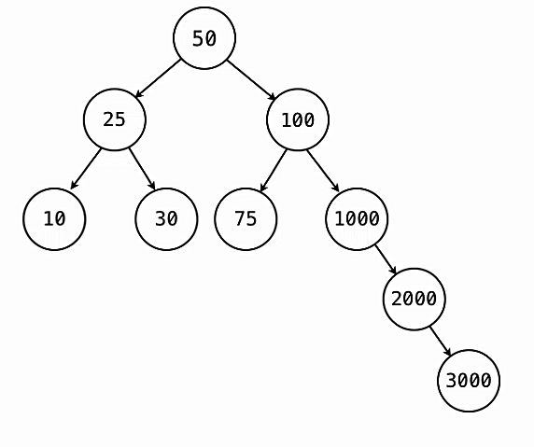
Binary search Tree
A binary search tree (BST) is a binary tree where each node has a Comparable key and satisfies:
The left sub-tree of a node has a key less than or equal to its parent node's key.
The right sub-tree of a node has a key greater than to its parent node's key.

Slide 47
Tree in languages
Go | N/A possible via struct
Python | N/A possible via class
Javascript | N/A possible via class
PHP | N/A possible via class

Slide 48
heap
Special Tree-based data structure in which the tree is a complete binary tree,
Generally, Heaps can be of two types:
Min-Heap
Max-Heap

Slide 49
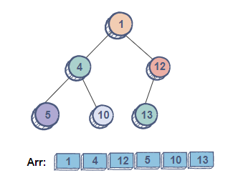
Min-heap
The root node has the minimum value.
The value of each node is equal to or greater than the value of its parent node.
A complete binary tree.

Slide 50
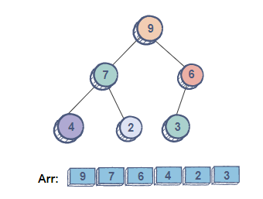
Max-heap
The root node has the maximum value.
The value of each node is equal to or less than the value of its parent node.
A complete binary tree.

Slide 51
Heap in languages
Go | container/heap
Python | heapq
Javascript | N/A possible via class
PHP | SplHeap, SplMinHeap, SplMaxHeap

Slide 52
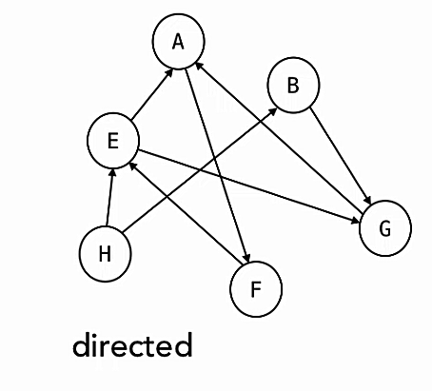
graphs
Collection of nodes where a node can link to another multiple node
Implementation:
Linked lists
Trees
Heaps

Slide 53
Graphs in languages
Go | graph
Python | N/A possible via class
Javascript | N/A possible via class
PHP | N/A possible via class

Slide 54
conclusion
Arrays:
Strength
Direct Indexing
Easy to create and use
Weaknesses
Sorting and searching
Inserting and deleting – particularly if not at start / end

Slide 55
conclusion
Linked List:
Strength
Inserting and deleting elements
Iterating through collection
Weaknesses
Direct Access
Searching and sorting

Slide 56
conclusion
Stacks and Queues:
Strength
Designed for LIFO/FIFO
Weaknesses
No Direct Access
Searching and Sorting

Slide 57
conclusion
Binary Search Tree:
Strength
Fast Insertion
Fast Retrieval
Stay sorted
Weaknesses
No Direct Access
Big Memory Allocation

Slide 58
conclusion
Static data structure tends to be fast
Dynamic data structures require dynamic storage allocation and reclamation/ some overhead
Used according to the needs of the application
We have built a good foundation to move ahead.

Slide 59
conclusion
Static data structure tends to be fast
Dynamic data structures require dynamic storage allocation and reclamation/ some overhead
Used according to the needs of the application
We have built a good foundation to move ahead.

